Slide 1

Literature Review
of HMP Scheduling
q big.LITTLE technology
”big” cores should provide maximal computing power
”LITTLE” cores are designed for maximum power efficiency
Peter Hu
Huawei Technologies Research & Development
CPU Team
19 June 2023

Slide 2
Table of Contents with references
Existing Linux CFS and EAS implementation
Ref: EAS Overview and Integration Guide, arm, 2018
https://docs.kernel.org/scheduler
Qualcomm HMP scheduler
Ref: EAS – Energy Aware Scheduler An unbiased look, Vitaly Wool, Konsulko Group
Multimedia, IEEE & Samsung Electronics saves system-wide (not just CPU) energy consumption by 8.9 percent
Ref: Enhancing Energy Efficiency of Multimedia Applications in Heterogeneous Mobile Multi-Core Processors (2017)
Abstraction Allocates multimedia applications to the small cores and non-multimedia applications to the big cores.
WAEAS, TSINGHUA SCIENCE AND TECHNOLOGY improves 5-8% when the workload was high
Ref: An Optimization Scheme of EAS Scheduler for Wearable Applications (2021)
BES-WALT Basic exponential smoothing-based WALT algorithm,
Energy-aware CPU selection algorithm,
Abstraction Adjusts Sched Tune
Latency-Sensitive Task: decrease searching speed to get minimum performance capacity and the lowest idle state
Non-Latency-Sensitive Task: not choose a lower utilization, but “task packing strategy” ( on the little cores )
Batch processing strategy,
Abstraction Adjusts select idle sibling()
Record and centralize on fewer cores
Cluster-based load balancing (overutilized)
Abstraction Reduces the meaningless task migration by local load balancing
( when having many aperiodic high-load applications )

Slide 3
Table of Contents with references
Fairness + energy efficiency
[HFEE]
Ref: Fairness-Aware Energy Efficient Scheduling on Heterogeneous Multi-Core Processors (2021).
[DTPM]
Ref: Algorithmic Optimization of Thermal and Power Management for Heterogeneous Mobile Platforms
[Min-Fair]
Ref:Exploring_the_Design_Space_of_Fair_Scheduling_Supports_for_Asymmetric_Multicore_Systems
[CEEF] surpasses Linux and four other schedulers in terms of fairness (58% ) and energy efficiency (37% on average)
Ref: Online energy‐efficient fair scheduling for heterogeneous multi‐cores considering shared resource contention (2022)

Slide 4
Table of Contents with references
Learning EAS, LG Electronics improves power consumption by 2.8% - 7.8%
Ref: Performance Improvement of Linux CPU Scheduler Using Policy Gradient Reinforcement Learning for Android Smartphones (2020)
Abstraction: Adjusts the TARGET_LOAD used to set the CPU frequency and the sched migration cost used as the task migration criteria
Using Policy reinforcement learning dealing with workload or the ratio of sleep and running states changes.
KylinTune for Browser Engine
Ref: DQN-based Energy-efficient Model for Browser in Mobile Devices
Abstraction: EAS and Q-table / Deep-Q Network (DQN) for setting schedtune.boost in Browser Engine

Slide 5
Other references
Wider coverage: Energy-Aware Scheduling for High-Performance Computing Systems: A Survey (2023)
Dispatch | Apple Developer Documentation

Slide 6
Existing Linux CFS and EAS implementation
Aim:
Performance.
Fairness
Terminology
Completely Fair Scheduler models an "ideal, precise multi-tasking CPU" on real hardware.
q CFS maintains the amount of time provided to a given task to determine if it needs balancing
§ the smaller amount of time a task has been permitted access to the processor — the higher its need for the processor is
q CFS maintains a time-ordered red-black tree, sorting tasks in ascending order by CPU bandwidth received
§ Instead of run queues as did predecessors § Guarantees O(log(N))
q The leftmost task off the red-black tree is picked up next § It has the least spent execution time § So that task gets the CPU to restore balance (fairness)
q Considers all CPUs to be the same § Works very well in SMP systems § Does not work in more complicated cases
Source: EAS – Energy Aware Scheduler An unbiased look, Vitaly Wool, Konsulko Group
Original CFS policy operates at full system utilization,
while EAS operates when the system has low/medium total utilization,
as EAS offers no energy benefit when all CPUs are overutilized
https://docs.kernel.org/scheduler/sched-design-CFS.html
https://docs.kernel.org/scheduler/sched-energy.html
EAS Overview and Integration Guide, arm, 2018

Slide 7
Existing Linux CFS and EAS implementation
Aim:
Energy-Efficiency and
Performance.
Fairness
Terminology
Energy = [joule] (resource like a battery on powered devices)
Power = energy/time = [joule/second] = [watt]
CPU Capacity = work_per_hz(cpu) * max_freq(cpu) Millions of Instructions Per Second (MIPS)
the performance a CPU can reach, normalized against the most performant CPU in the system.
Heterogeneous systems have asymmetric CPU capacity.
The goal of EAS is to minimize energy, while still getting the job done.
maximize: performance [inst/s] / Power [W] minimize: Energy [J] / instruction
EAS:
To break the tie between several good CPU candidates and pick the one that is predicted to yield the best energy consumption without harming the system's throughput when deciding which a task should run during wake-up.
Rely on specific elements about the platform's topology, the 'capacity' of CPUs, and their respective energy costs.
https://docs.kernel.org/scheduler/sched-design-CFS.html
https://docs.kernel.org/scheduler/sched-energy.html
EAS Overview and Integration Guide, arm, 2018

Slide 8
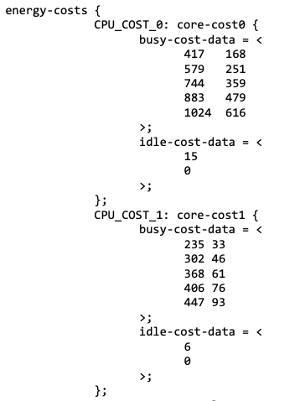
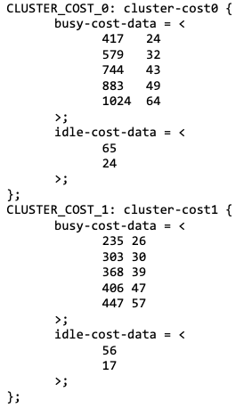
Device Tree Source File / Energy Model
EAS Overview and Integration Guide, arm, 2018

Slide 9
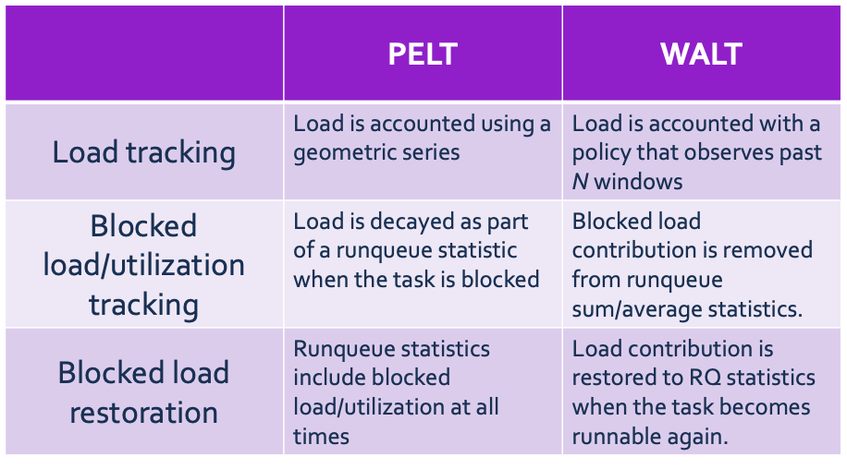
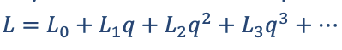
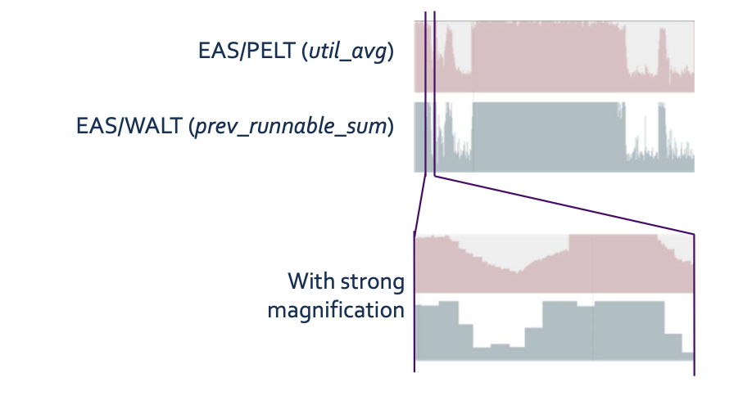
Existing Linux CFS and EAS implementation
Energy-Efficiency and
Performance.
Fairness
Terminology
Load Tracking Mechanism
Per- Entity Load Tracking (PELT) - focused only on a single class - CFS
Let Li designate the entity's load contribution in period pi
§ Then the total load is q is the decay factor
Window Assist Load Tracking (WALT) - EAS
faster reaction times when the behaviour of tasks changes.
uses periodic calculations that are synchronized across all of the run queues, attempting to track the behaviour of all scheduling classes.
✅ the decisions can be made based on the information
about the full state of the running system.
❌ additional locking complexity and some additional delays in other pathways
https://docs.kernel.org/scheduler/sched-design-CFS.html
https://docs.kernel.org/scheduler/sched-energy.html
EAS Overview and Integration Guide, arm, 2018

Slide 10
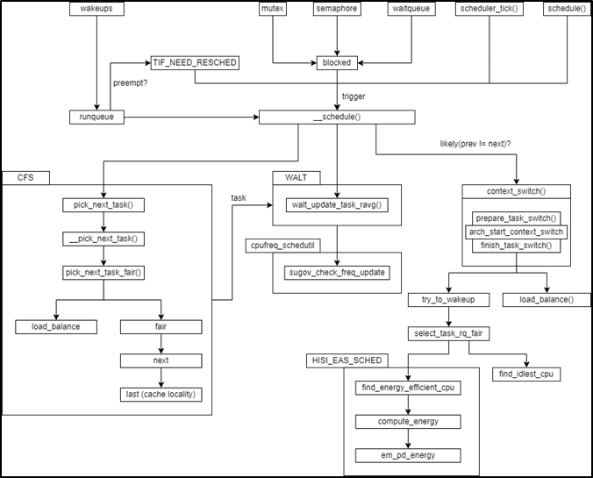
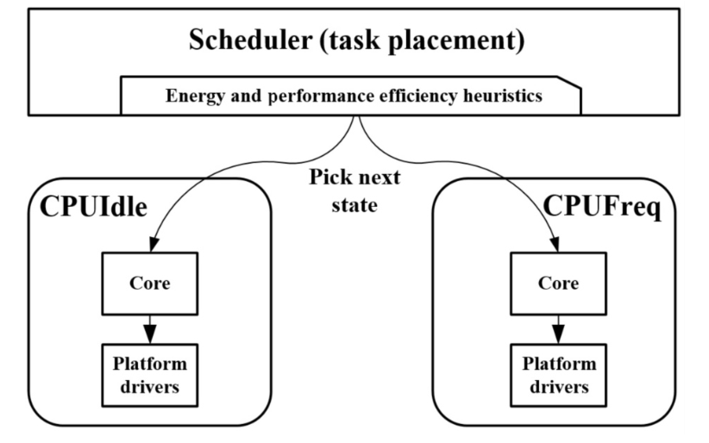
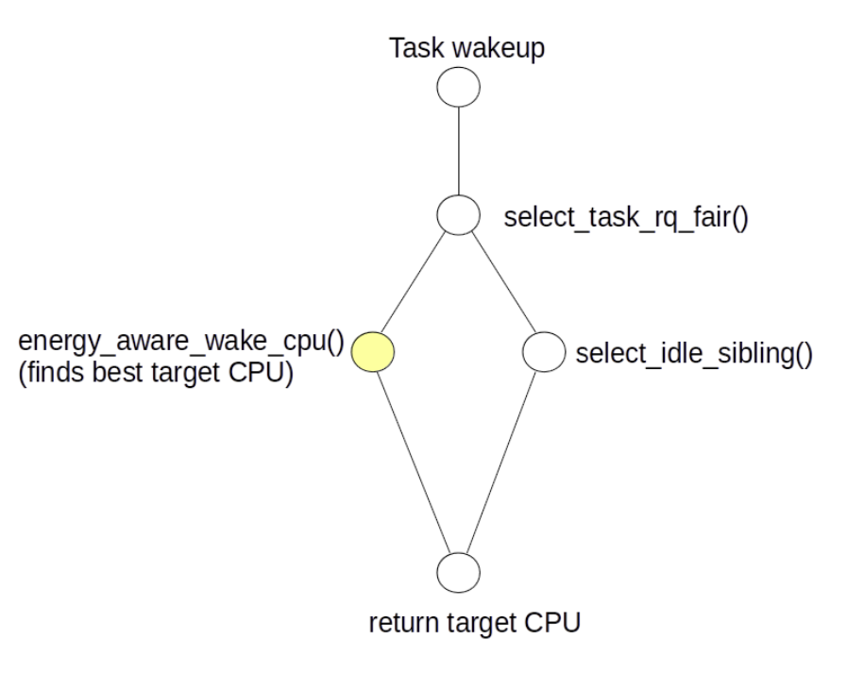
Existing Linux CFS and EAS implementation
CPU capacity
a measure of the performance a CPU can reach, normalized against the most performant CPU in the system.
from time to time explicitly
'over-utilized’
used at more than 80%
of their compute capacity
Figure 2 Task wakeup path modifications. (The yellow dots represent EAS functionality)

Slide 11
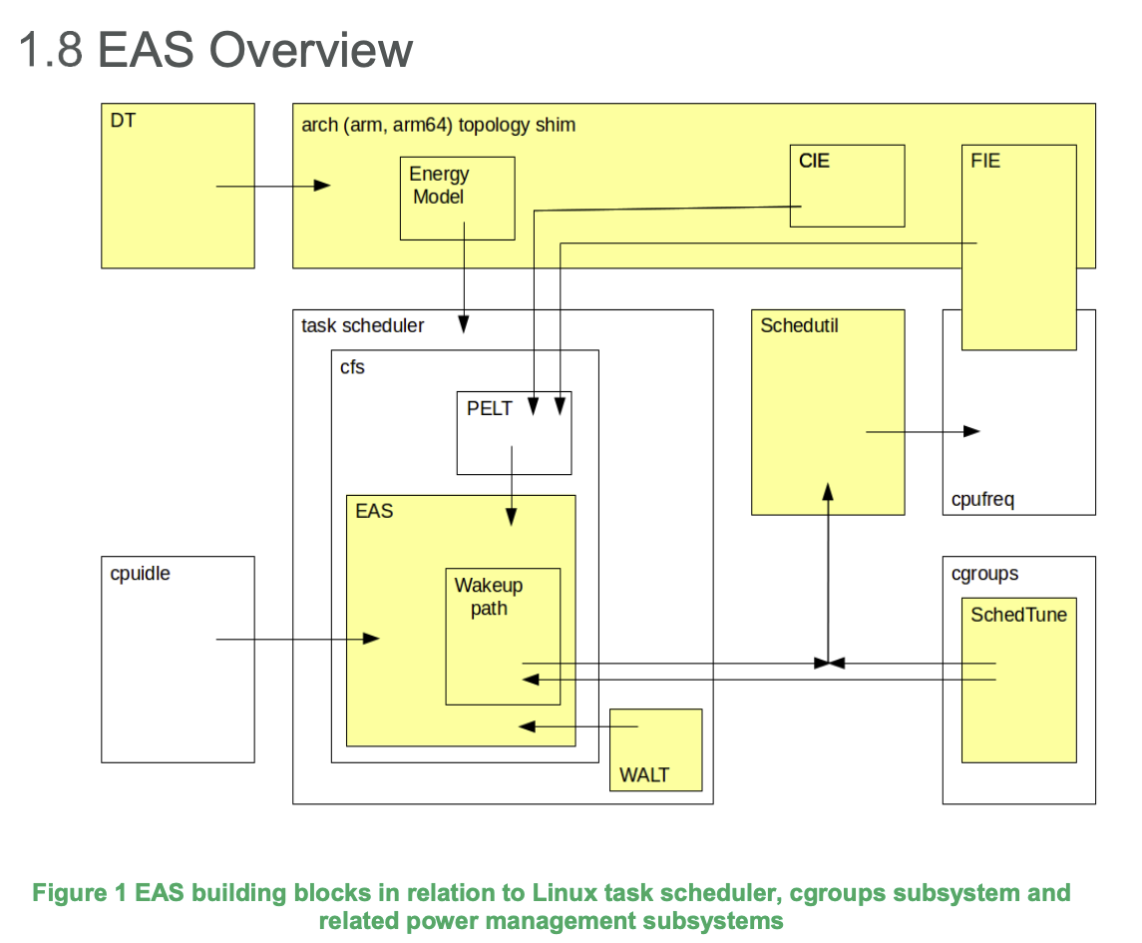
Existing Linux CFS and EAS implementation
EAS Overview and Integration Guide, arm, 2018

Slide 12
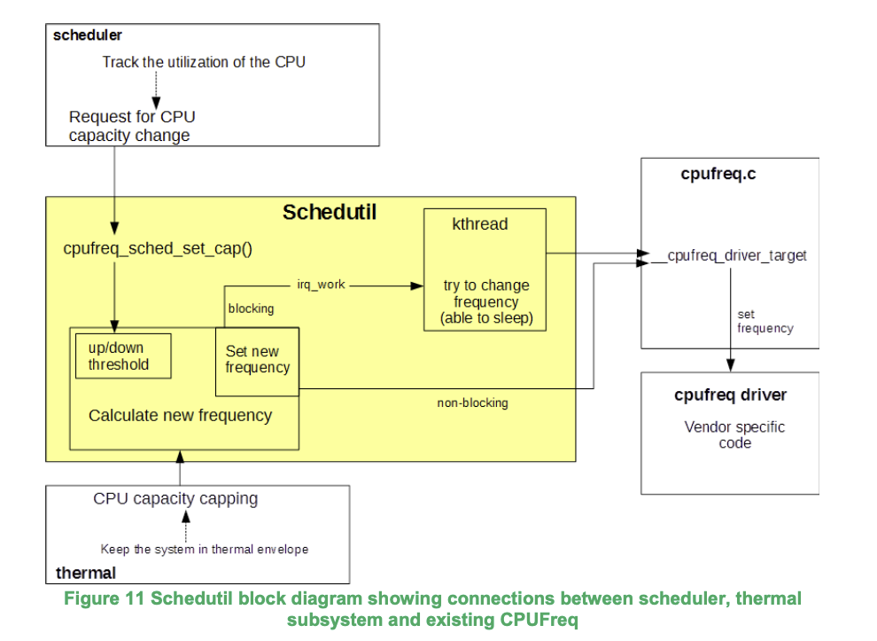

Sched util - Scheduler driven DVFS
EAS Overview and Integration Guide, arm, 2018

Slide 13
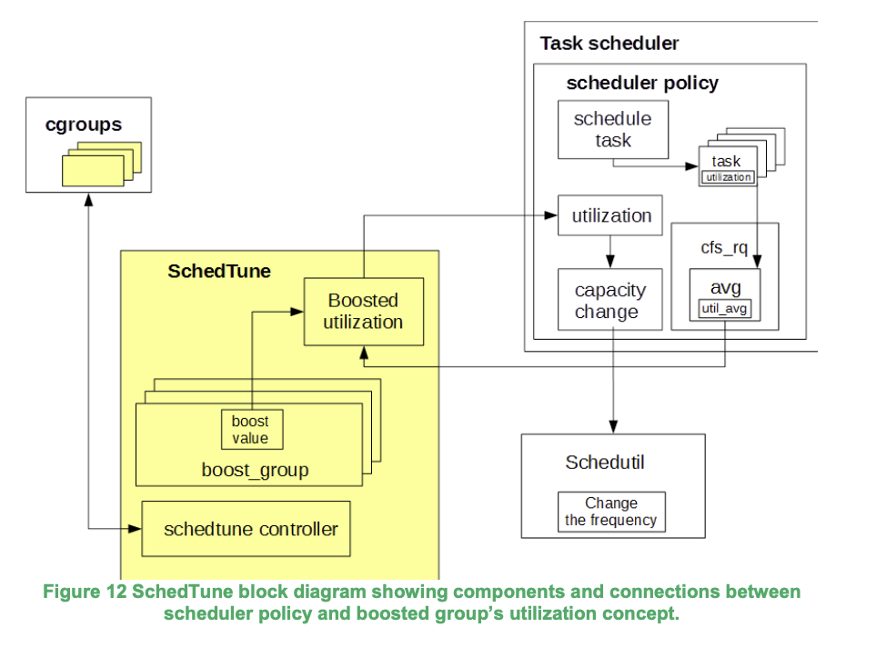
Sched Tune - Task classification and control
EAS Overview and Integration Guide, arm, 2018

Slide 14
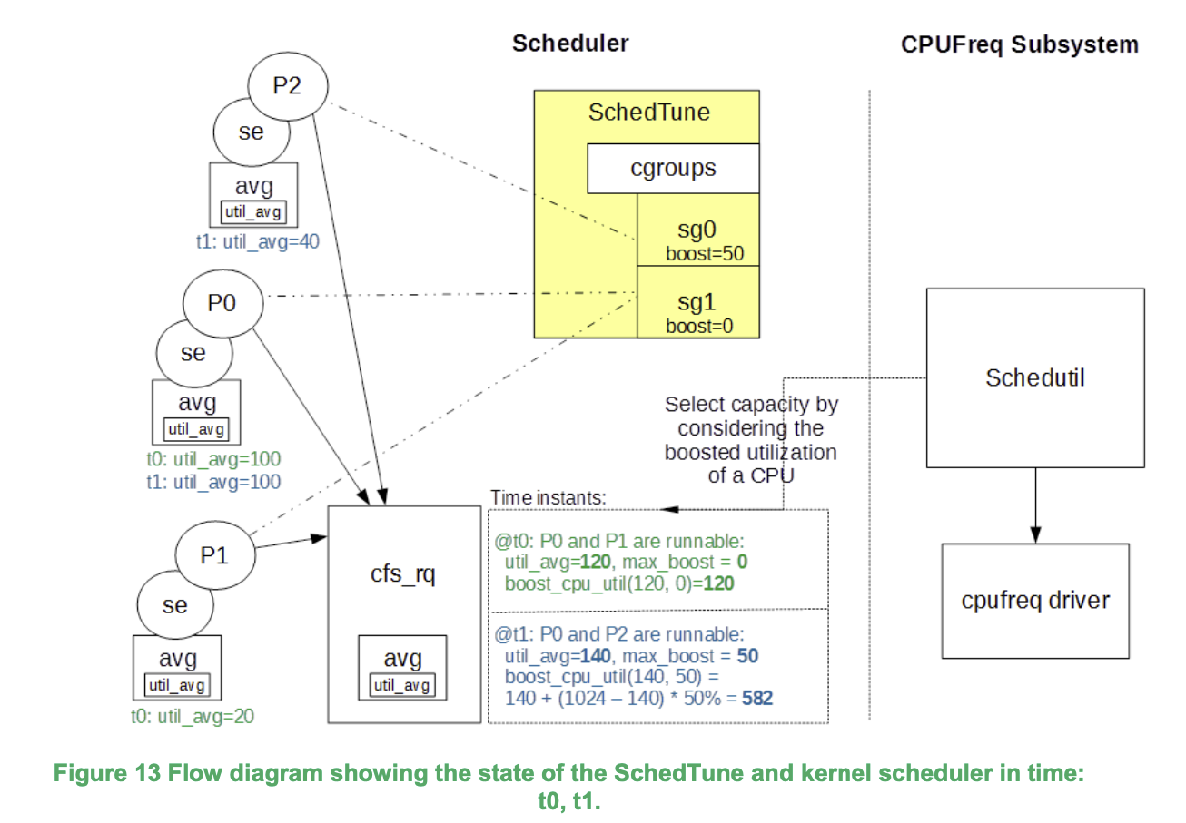
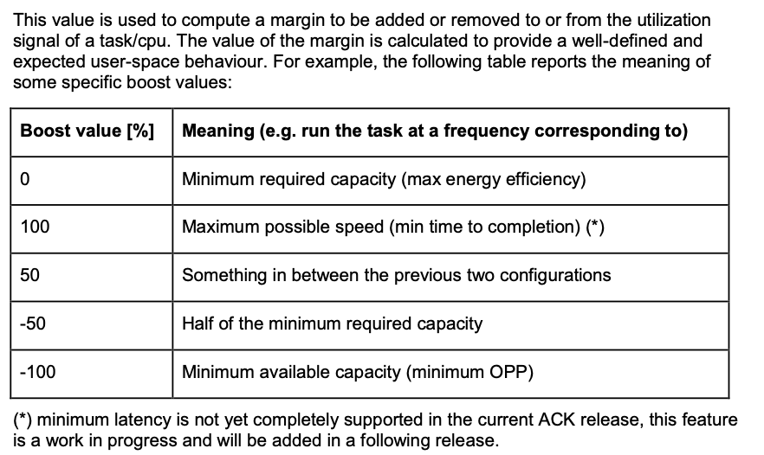
EAS Overview and Integration Guide, arm, 2018

Slide 15
Existing Linux CFS and EAS implementation
Aim:
Energy-Efficiency and
Performance.
Fairness
Terminology
Energy = [joule] (resource like a battery on powered devices)
Power = energy/time = [joule/second] = [watt]
The goal of EAS is to minimize energy, while still getting the job done.
maximize: performance [inst/s] / Power [W] minimize: Energy [J] / instruction
EAS:
To break the tie between several good CPU candidates and pick the one that is predicted to yield the best energy consumption without harming the system's throughput when deciding which a task should run during wake-up.
Rely on specific elements about the platform's topology, the 'capacity' of CPUs, and their respective energy costs.
https://docs.kernel.org/scheduler/sched-design-CFS.html
https://docs.kernel.org/scheduler/sched-energy.html
EAS Overview and Integration Guide, arm, 2018

Slide 16
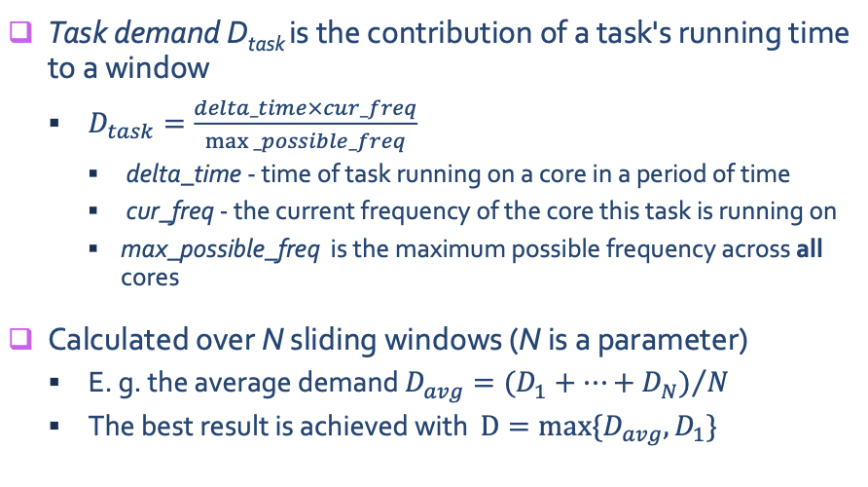
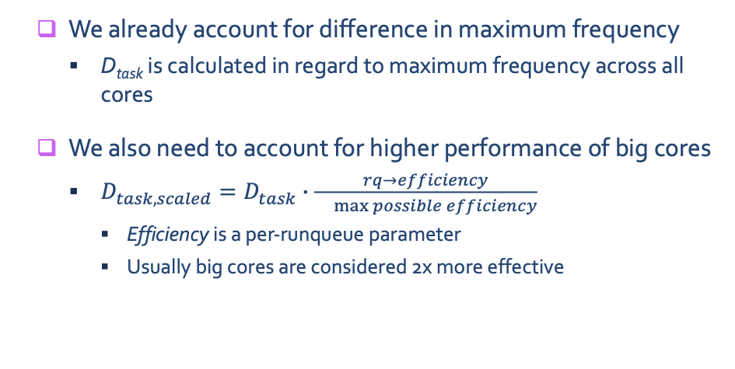
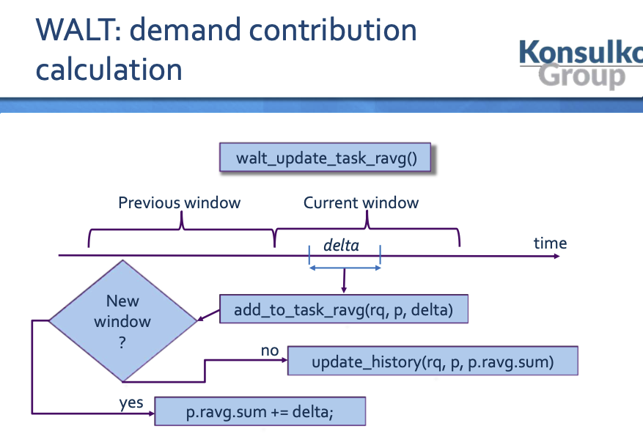
Existing Linux CFS and EAS implementation
Qualcomm HMP scheduler
1.25*D -- 80% capcity
EAS – Energy Aware Scheduler An unbiased look, Vitaly Wool, Konsulko Group

Slide 17
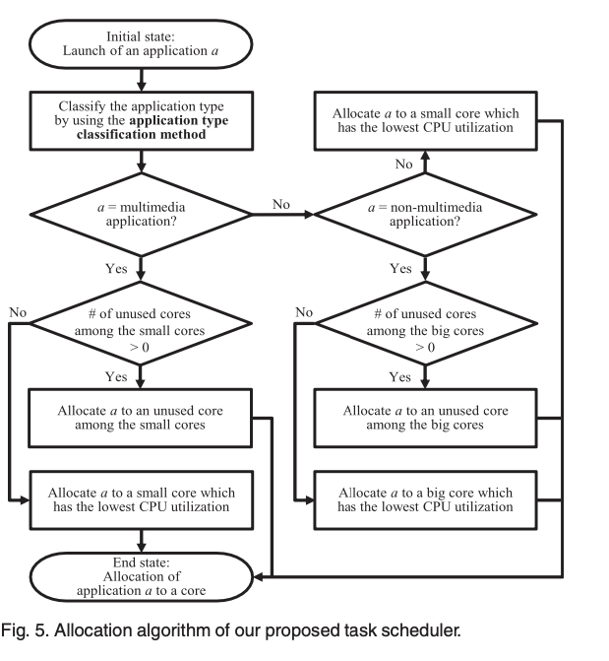
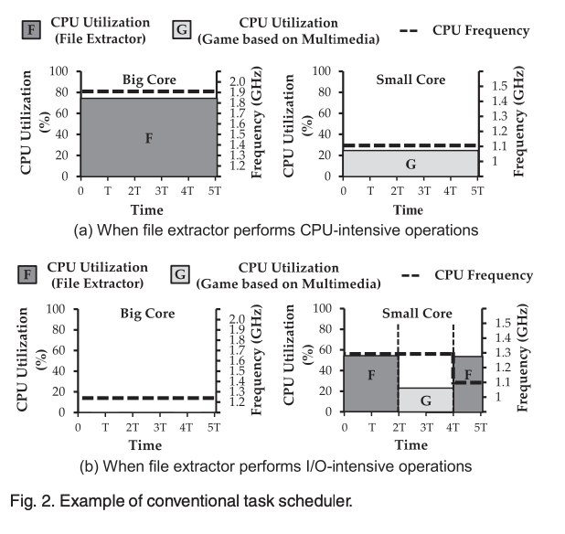
Multimedia
To eliminate the above inefficiency of the conventional task scheduler, we propose an advanced task scheduler for heterogeneous mobile multi-core processors. Our proposed task scheduler allocates multimedia applications to the small cores and non-multimedia applications to the big cores.
Since recent smart devices have employed dedicated hardware decoders for multimedia applications
Enhancing Energy Efficiency of Multimedia Applications in Heterogeneous Mobile Multi-Core Processors (2017)

Slide 18
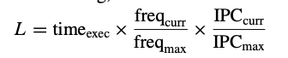
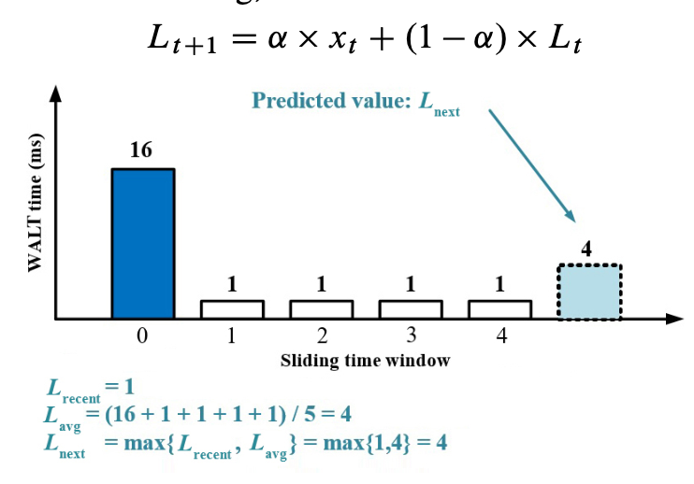
WAEAS
This paper analysed performance energy efficiency in the dynamic scheduling of latency-sensitive and non-latency- sensitive tasks for heterogeneous multicore wearable systems. By aiming to improve the energy efficiency of workload prediction, CPU core selection, and load balancing without affecting performance, the authors further optimized the EAS scheduler and proposed WAEAS, such as
BES-WALT Basic exponential smoothing-based WALT algorithm,
Lt represents the predicted demand in the t-th sliding window,
xt represents the real demand in the t-th sliding window, ̨
represents the smoothing factor, where ̨a is in [0,1]
WAEAS: An Optimization Scheme of EAS Scheduler for Wearable Applications (2021)

Slide 19
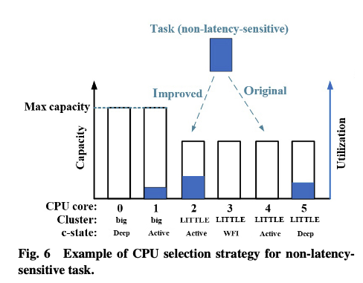
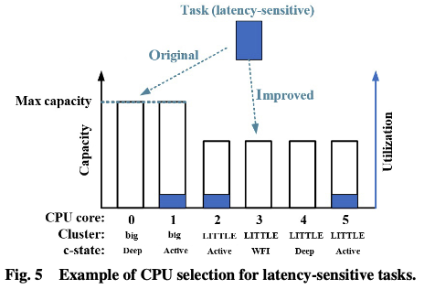
WAEAS
This paper analysed performance energy efficiency in the dynamic scheduling of latency-sensitive and non-latency- sensitive tasks for heterogeneous multicore wearable systems. By aiming to improve the energy efficiency of workload prediction, CPU core selection, and load balancing without affecting performance, the authors further optimized the EAS scheduler and proposed WAEAS, such as
BES-WALT Basic exponential smoothing-based WALT algorithm,
Energy-aware CPU selection algorithm,
Sched Tune
Latency-Sensitive Task: decrease searching speed to get minimum performance capacity and the lowest idle state
Non-Latency-Sensitive Task: not choose a lower utilization, but “task packing strategy” ( on the little cores )
WAEAS: An Optimization Scheme of EAS Scheduler for Wearable Applications (2021)

Slide 20
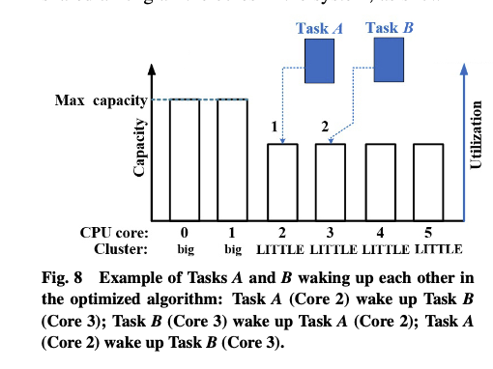
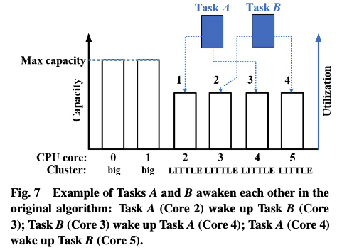
WAEAS
This paper analysed performance energy efficiency in the dynamic scheduling of latency-sensitive and non-latency- sensitive tasks for heterogeneous multicore wearable systems. By aiming to improve the energy efficiency of workload prediction, CPU core selection, and load balancing without affecting performance, the authors further optimized the EAS scheduler and proposed WAEAS, such as
BES-WALT Basic exponential smoothing-based WALT algorithm,
Energy-aware CPU selection algorithm,
Batch processing strategy,
select idle sibling()
The proposed strategy records which core the task was running on as the awakener at the last time, and runs the tasks in the system centralized on fewer cores, which not only reduces the migration of tasks in the system, but also makes more cores in the system be in the idle state.
WAEAS: An Optimization Scheme of EAS Scheduler for Wearable Applications (2021)

Slide 21
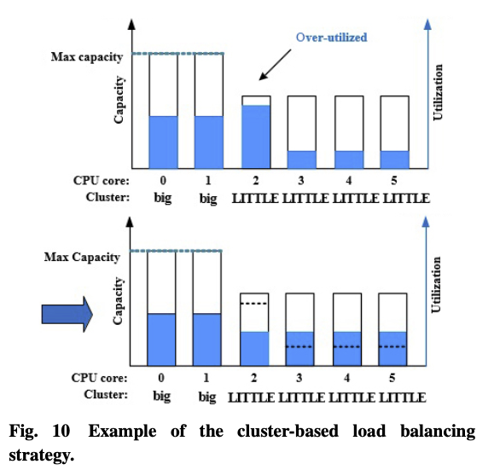
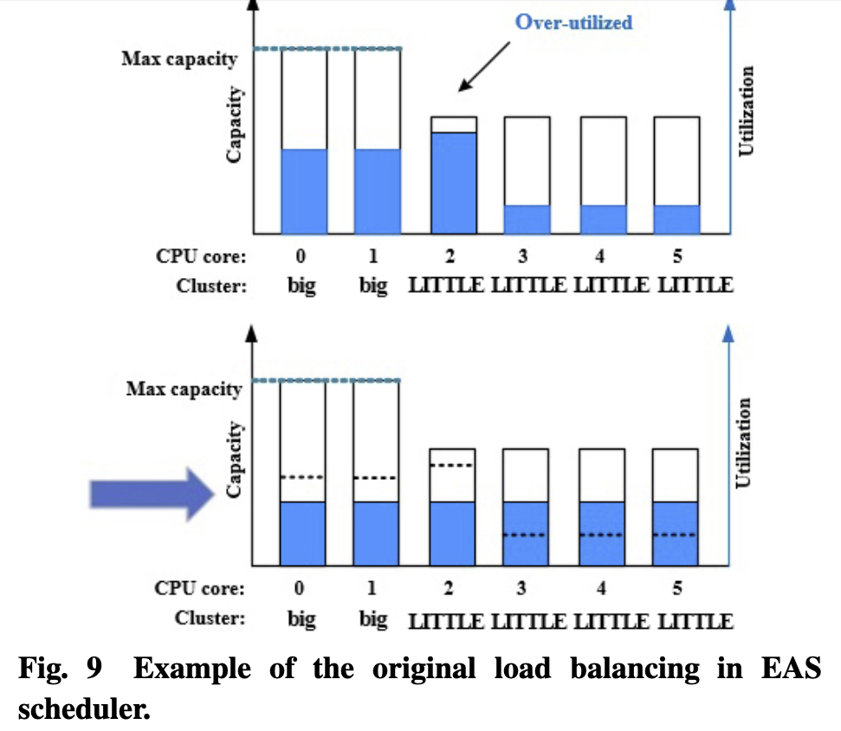
WAEAS
This paper analysed performance energy efficiency in the dynamic scheduling of latency-sensitive and non-latency- sensitive tasks for heterogeneous multicore wearable systems. By aiming to improve the energy efficiency of workload prediction, CPU core selection, and load balancing without affecting performance, the authors further optimized the EAS scheduler and proposed WAEAS, such as
BES-WALT Basic exponential smoothing-based WALT algorithm,
Energy-aware CPU selection algorithm,
Batch processing strategy,
Cluster-based load balancing (overutilized)
aperiodic high-load applications
reduces the meaningless task migration
by local load balancing
sets an overutilized indicator in the big core scheduling subdomain and the little core scheduling subdomain, respectively, thereby indicating that whether the domain is overutilized or not. When a scheduling domain is overutilized, the current domain state is set to be overutilized first, and the load balancing in the current domain is given a priority
WAEAS: An Optimization Scheme of EAS Scheduler for Wearable Applications (2021)

Slide 22
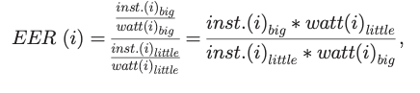
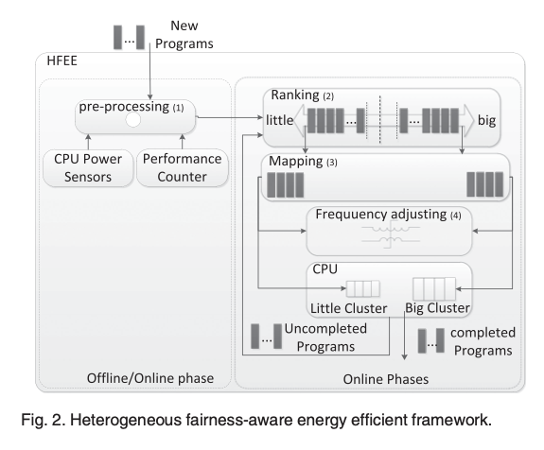
Fairness + energy efficiency
[HFEE]
Ref: Fairness-Aware Energy Efficient Scheduling on Heterogeneous Multi-Core Processors (2021).
Pre-processing exploits CPU power sensors and performance counters to identify the Energy Efficiency Ratio of each program;
Ranking specifies a program’s suitability score for the two big and little clusters;
Mapping maximizes energy efficiency through choosing appropriate programs for each cluster after the programs have been ranked;
Frequency scaling guaranties fairness threshold through proper frequency selection. The following subsections fully describe the different parts of the HFEE framework.
Fairness-Aware Energy Efficient Scheduling on Heterogeneous Multi-Core Processors (2021).

Slide 23
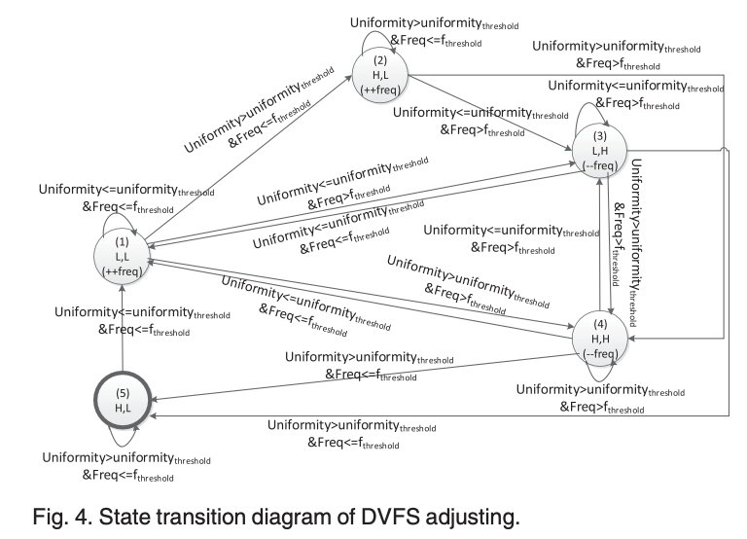
Fairness + energy efficiency
[HFEE]
Ref: Fairness-Aware Energy Efficient Scheduling on Heterogeneous Multi-Core Processors (2021).
Pre-processing exploits CPU power sensors and performance counters to identify the Energy Efficiency Ratio of each program;
Ranking specifies a program’s suitability score for the two big and little clusters;
Mapping maximizes energy efficiency through choosing appropriate programs for each cluster after the programs have been ranked;
Frequency scaling guaranties fairness threshold through proper frequency selection. The following subsections fully describe the different parts of the HFEE framework.
Fairness-Aware Energy Efficient Scheduling on Heterogeneous Multi-Core Processors (2021).

Slide 24
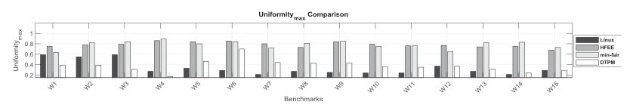
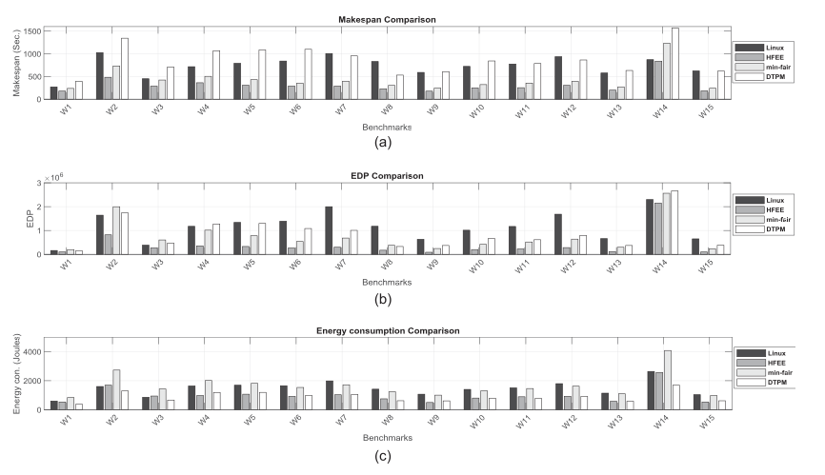
Fairness + energy efficiency
[HFEE]
Ref: Fairness-Aware Energy Efficient Scheduling on Heterogeneous Multi-Core Processors (2021).
[DTPM]Ref: Algorithmic Optimization of Thermal and Power Management for Heterogeneous Mobile Platforms
[Min-Fair] Ref:Exploring_the_Design_Space_of_Fair_Scheduling_Supports_for_Asymmetric_Multicore_Systems
The proposed framework (HFEE) uses little cluster when the number of programs is more than big cluster core count. It does not use little cluster, in case the program count is lower than big cluster core count. This improves make span consequently.
Min-Fair scheduler tries to reach higher fairness by almost equal usage of big and little clusters. This policy improves fairness at the cost of higher make span. Min-Fair uses both big and little clusters to improve fairness even when the program count is lower than big cluster core count which degrades make span. However, HFEE uses big cluster in these cases which improves make span.
DTPM just tries to save energy consumption and do not consider fairness. This scheduler uses little cluster more than the big cluster to improve energy consumption, therefore, it results in longer make span.
Linux standard scheduler is heterogeneity agnostic and uses little cluster more than big cluster, which results in higher make span.
Fairness-Aware Energy Efficient Scheduling on Heterogeneous Multi-Core Processors (2021).

Slide 25
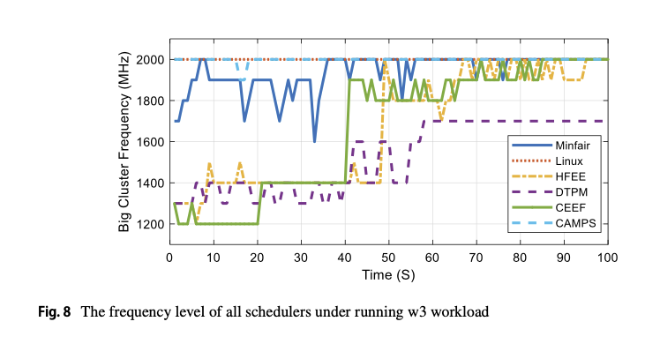
Fairness + energy efficiency
[HFEE]
Ref: Fairness-Aware Energy Efficient Scheduling on Heterogeneous Multi-Core Processors (2021).
[DTPM]Ref: Algorithmic Optimization of Thermal and Power Management for Heterogeneous Mobile Platforms
[Min-Fair] Ref:Exploring_the_Design_Space_of_Fair_Scheduling_Supports_for_Asymmetric_Multicore_Systems
[CEEF]
Ref: Online energy‐efficient fair scheduling for heterogeneous multi‐cores considering shared resource contention (2022)
Online energy‐efficient fair scheduling for heterogeneous multi‐cores considering shared resource contention (2022)

Slide 26
Learning EAS
The Learning EAS adjusts the TARGET_LOAD used to set the CPU frequency and the sched_migration_cost used as the task
migration criteria according to the characteristics of the running task through the policy gradient reinforcement learning.
Effects:
In LG G8 ThinQ, Learning EAS improved power consumption by 2.3% - 5.7%, hackbench results for process scheduling performance by 2.8% - 25.5%, applications entry time by 4.4% - 6.1%, and applications entry time under high CPU workload by 9.6% - 12.5%, respectively compared with EAS. This paper also showed that the Learning EAS is scalable by applying the Learning EAS to high- end and low-end chipset platforms of Qualcomm.Inc and MediaTek.Inc and improving power consumption by 2.8% - 7.8%, application entry time by 2.2% - 7.2%, respectively compared with EAS. Finally, this paper showed that the performance of CPU scheduling is improved gradually by the repetition of reinforcement learning.
Performance Improvement of Linux CPU Scheduler Using Policy Gradient Reinforcement Learning
for Android Smartphones (2020)

Slide 27
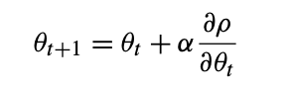
Learning EAS
Motivation:
EAS generally provides good performance because many of the values which are basis for the operation are fixed.
In general, each task has its own characteristics for changing workload.
It also has unique properties for transition between running state and sleep state.
It is difficult to optimize the performance by using simple algorithm which changes the default value for the
EAS operation when a task’s workload or the ratio of sleep and running states gets to change above or below a certain value.
Solution:
Set the values of the EAS operation criteria dynamically according to the characteristics of the running tasks
to improve performance, which can be achieved through policy gradient reinforcement learning.
updating parameter vector
ρ policy performance measure
α learning rate
Performance Improvement of Linux CPU Scheduler Using Policy Gradient Reinforcement Learning
for Android Smartphones (2020)

Slide 28
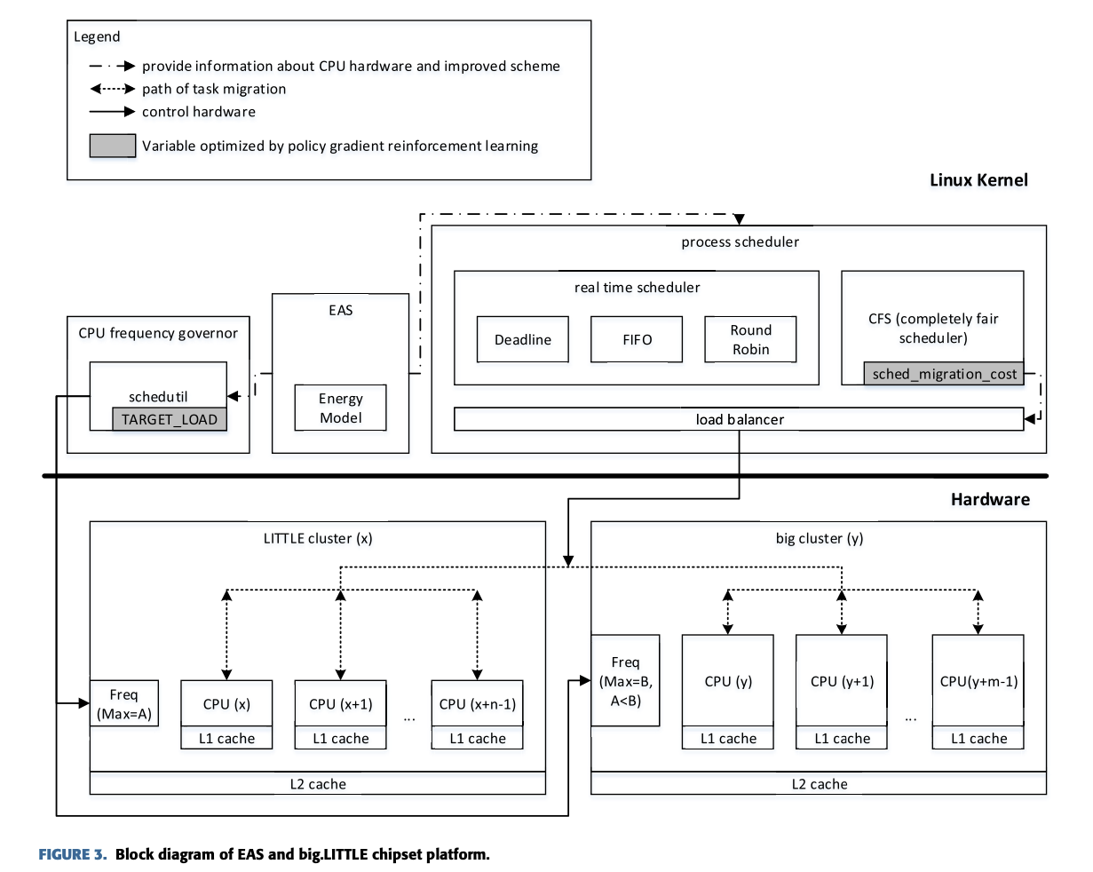
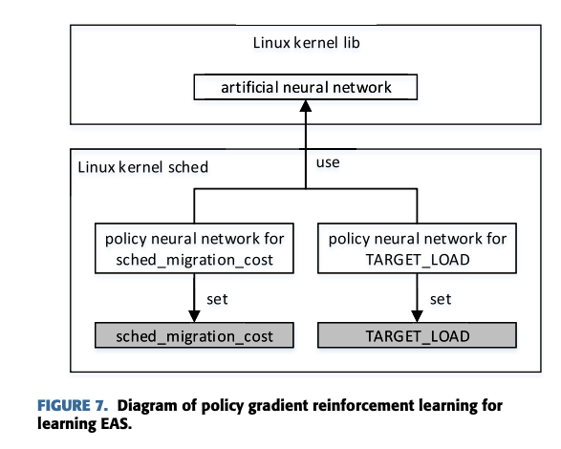
Learning EAS
Motivation:
EAS generally provides good performance because many of the values which are basis for the operation are fixed.
In general, each task has its own characteristics for changing workload.
It also has unique properties for transition between running state and sleep state.
It is difficult to optimize the performance by using simple algorithm which changes the default value for the
EAS operation when a task’s workload or the ratio of sleep and running states gets to change above or below a certain value.
updating parameter vector
α learning rate
Performance Improvement of Linux CPU Scheduler Using Policy Gradient Reinforcement Learning
for Android Smartphones (2020)

Slide 29
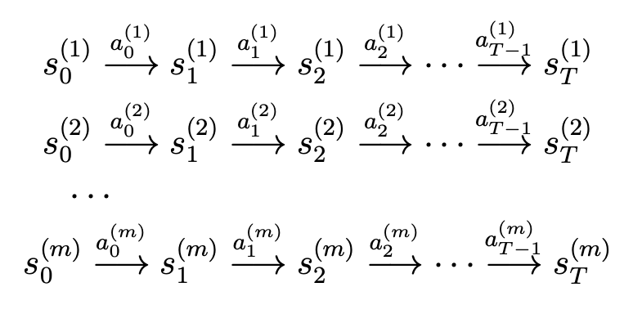
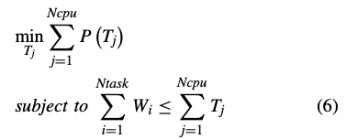
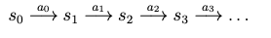
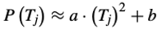
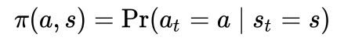
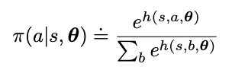
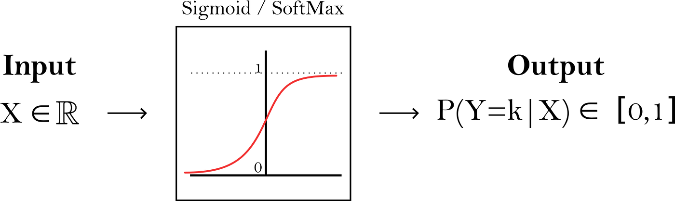
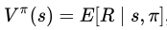
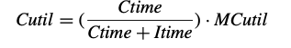
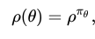

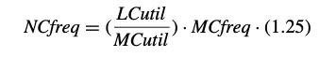
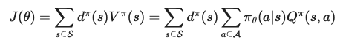
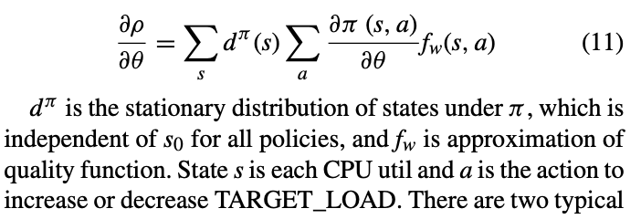
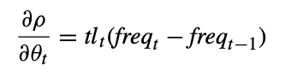
Learning EAS
Optimal Value Function
State s each CPU util
Action a increase or decrease TARGET_LOAD
Policy π : S × A → [0,1]
the agent's action selection, π mapping from the states to the actions.
Stationary Probability
State-value function V : S × π → R
Action-value function fw/Q: S × π → R Expected return
Performance Function ρ θ space → policies πθ space
parameter θ the policy that increases or decreases TARGET_LOAD which affects the next CPU frequency change.
Action Preference Function h(s, a, theta)
CPU workload ≤ CPU throughput
In schedutil, each CPU workload is
expressed as
Max
largest CPU util in the cluster
Next
Reward function
Direct policy search:
Updating parameter vector
α learning rate
Policy Gradient Theorem
current TARGET_LOAD
change value
Thus when π (s, a) is partially differentiated against θ, it is the rate of the CPU frequency change.
CS229 Ch 16.Reinforcement
Learning and Control
https://en.wikipedia.org/wiki/Reinforcement_learning
https://lilianweng.github.io/posts/2018-04-08-policy-gradient/
Performance Improvement of Linux CPU Scheduler Using Policy Gradient Reinforcement Learning
for Android Smartphones (2020)

Slide 30
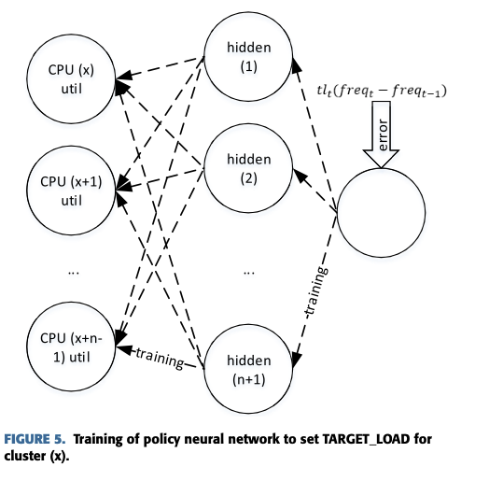


Learning EAS
optimal value function
CPU workload ≤ CPU throughput
In schedutil, each CPU workload is expressed as
Next
updating parameter vector
α learning rate
current TARGET_LOAD
change value
Performance Improvement of Linux CPU Scheduler Using Policy Gradient Reinforcement Learning
for Android Smartphones (2020)

Slide 31


Learning EAS
Next
α learning rate
Performance Improvement of Linux CPU Scheduler Using Policy Gradient Reinforcement Learning
for Android Smartphones (2020)

Slide 32

KylinTune for Browser
At present, the two most popular classes of reinforcement learning algorithms are Q Learning and Policy Gradients. Q learning is a type of value iteration method aims at approximating the Q function, while Policy Gradients is a method to directly optimize in the action space.
State:
Ssize is the size of the webpage, Snode is the number of the DOM tree nodes, Sdepth is the depth of the DOM tree, S#style is the number of the style attributes in HTML, and S#link is the number of link tags in HTML
Action:
Schedtune is a type of cgroup. The schedtune.boost file provides an interface for each schedtune cgroup to adjust the execution speed of the specific process. We select the value of schedtune.boost ranging from -90 to 90 and take 20 as an interval, so we get ten actions.
DQN-based Energy-efficient Model for Browser in Mobile Devices

Slide 33
Thank you!
Best of Luck~
Peter Hu
Huawei Technologies Research & Development
CPU Team

